Slide 1
Introduction to Artificial Intelligence

Slide 2
Artificial intelligence ?
AI is the science and engineering of making intelligent machines.
The theory and development of computer systems able to perform tasks normally requiring human intelligence , such as visual perception, speech recognition, decision making and translation between languages

Slide 3
Why are we talking about AI now?
More computational power , GPUs
  Can implement AI is daily aspects
We have lot of data, Big data
  Social media, IoT devices
  We need method to process so much data
  Go inside data and grow businesses.
Better algorithms like NN, can do better and quicker computations
All are investing in AI; AMAZON, facebook , microsoft.

Slide 4
Under AI
Knowledge base
Expert systems
Deep learning
Computer vision and image processing
Machine learning
Natural language processing

Slide 5

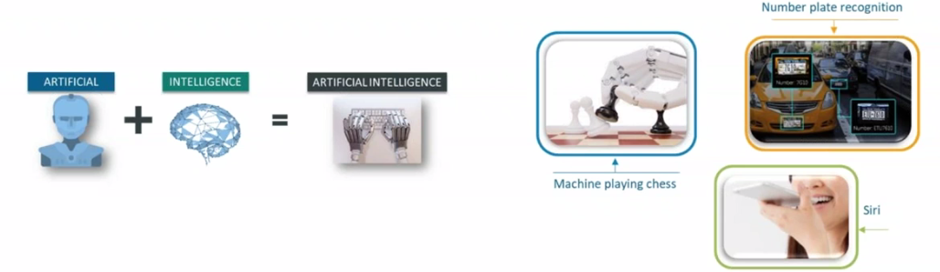

Slide 6
AI Applications
J.P Morgan uses AI and machine learning and image recognition software to analyze legal documents
IBM Watson health care for medical diagnosis and can able to analyze 2 million records and look for diseases.
Google AI eye doctor can examine retina scan and can detect disease that can cause blindness.
Facebook uses it to detect facial features and tag friends (auto tagging feature is backed by ML and AI)

Slide 7
AI Applications
Tweeter AI, that can detect any sort of hate speech.
Terrorist-linked accounts ,95% by non-human and AI based machines.
Google assistant, Alexa and Siri.
  Newly released is Google Duplex
Tesla- Shelf driving cars can automatically detect objects . “robo taxi”
Netflix , personalize movie recommendation systems. 75% recommendation are correct.
Gmail for spam and non-spam.

Slide 8
Types of AI
Artificial narrow intelligence
Artificial General intelligence
Artificial Super intelligence

Slide 9
Artificial narrow intelligence
Weak AI
Applying AI only to specific tasks.
Mostly operating as weak AI
  Alexa , google search engines , self driving cars
  It operates within limit of pre defined tasks.
  No sophisticated intelligence involved.

Slide 10
Artificial General intelligence
Also know as strong AI.
It involve machines that can perform any intelligent task that humans can do.
Machines do not posses human like abilities.
Machine can process million documents in matter of second
Or if you ask machine to go to your room and switch off the TV ? Machine will take for ever to learn that.
  Machine can’t think that way.
That why we are stuck on narrow intelligence

Slide 11
Artificial Super intelligence
Capability of computers will surpass humans
It will take a while to achieve that.
Seen as hypothetical situation.
  Movies and science fiction books, machine have taken over the world. i.e terminator
  Prediction is year 2040?

